Slide 1
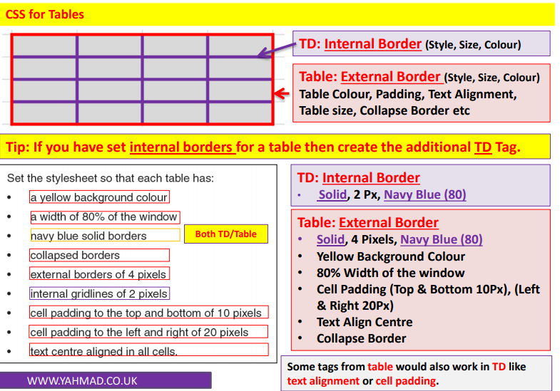
Web Authoring

Slide 2
Web Authoring
Task 1– Set the style sheet so each table has:
Create a new CSS called tablestyle.CSS
Table CSS
Table | Green Background
 | Height: 200px, Width 400px
 | External Borders – 3 px, Red
 | Internal Borders – 2px, Blue | TD
 | Cell Padding to the top and bottom of 10px
 | Text centre aligned in all cells
 | All Borders Solid
 | Collapsed Borders
Body | Yellow Background
Set your name as a comment /*Name*/

Slide 3
Web Authoring
Task 2 – Create Table
Create a new html file called Tables.htm and attach the style sheet created in step 1. Create the tables shown below and apply appropriate labels.
Table 1
Table 2

